Slide 1
Building Energy Consumption Classification
Dr. Lewe
Kunal Sharma
Georgia Tech

Slide 2
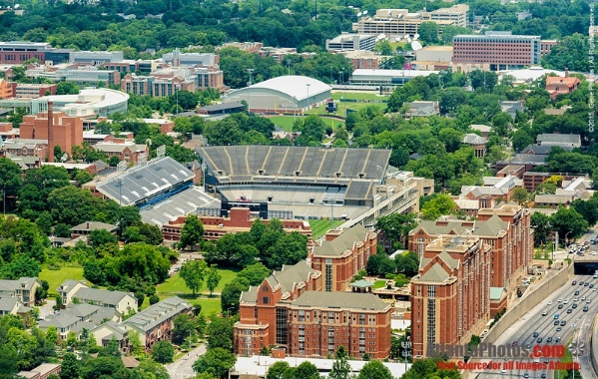

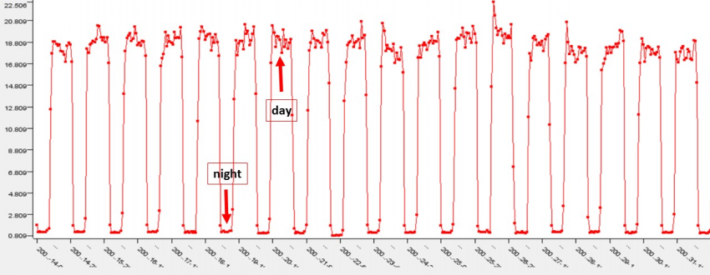
Data Collection
Energy Used by 134 Campus Buildings
Data Stored in Servers
Energy Data Used for Classification

Slide 3

ML Studies The Data
Machine Learning Model

Slide 4
Multiple ML Models
Decision Trees
Random Forest
KNN
SVM
Artificial Neural Networks
Naïve Bayes
Logistic Regression

Slide 5

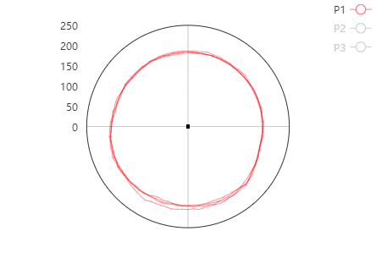
Model Classification
Cocentric!
Building #47 Energy Plot
People!
Cocentric!
People!
Random!
Cocentric!
Actual Classification: Cocentric
Cocentric!

Slide 6
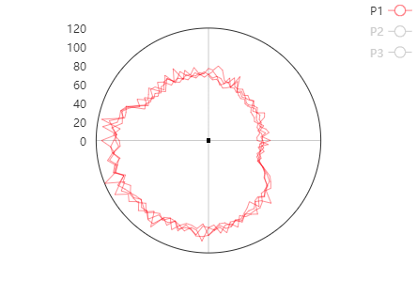
Model Classification
People!
Building #63 Energy Plot
Cocentric!
Random!
People!
Cocentric!
Cocentric!
Actual Classification: People
People!

Slide 7
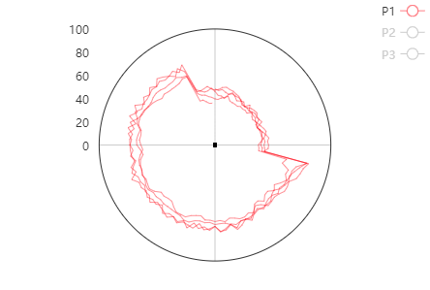
Model Classification
Scheduler!
Building #63 Energy Plot
Cocentric!
Scheduler!
Scheduler!
Cocentric!
Scheduler!
Actual Classification: Scheduler
People!

Slide 8
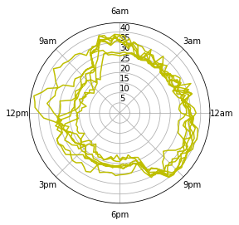
Model Classification
Scheduler!
Building #63 Energy Plot
Reverse!
Reverse!
Scheduler!
Cocentric!
Reverse!
Actual Classification: Reverse
Reverse!

Slide 9
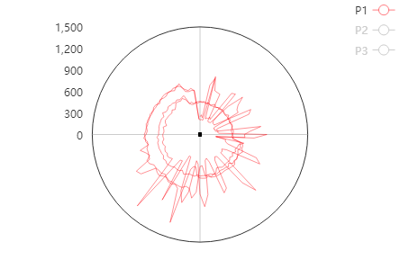
Model Classification
Random!
Building #63 Energy Plot
Random!
Reverse!
Random!
Random!
Reverse!
Actual Classification: Random
Reverse!

Slide 10
Fire Models with Low Accuracies
68%
86%
88%
43%
86%
38%
41%
Decision Trees
Random Forest
KNN
SVM
Artificial Neural Networks
Naïve Bayes
Logistic Regression

Slide 11

Weighted Voting-Based Classification
Building #63 Energy Plot
Random Forest
People!
Cocentric!
People!
KNN
Artificial Neural Networks
People!
Actual Classification: People

Slide 12

Voting has a Higher Accuracy
90%
86%
86%
88%
Voting
Artificial Neural Networks
Random Forest
KNN

Slide 13
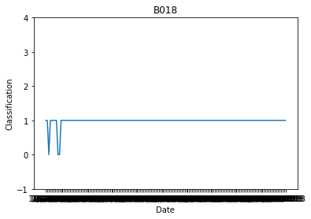
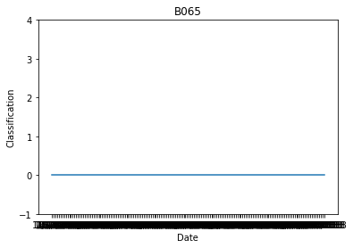








Voting Classification of Buildings – Normal
Jan Feb Mar Apr May Jun July Aug
Jan Feb Mar Apr May Jun July Aug
(2018)
(2018)

Slide 14
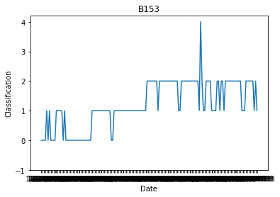
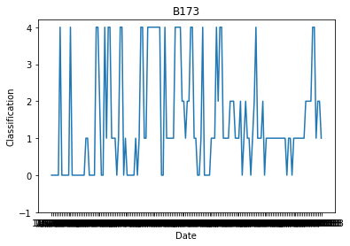


Voting Classification of Buildings – Abnormal
Jan Feb Mar Apr May Jun July Aug
Jan Feb Mar Apr May Jun July Aug
(2018)
(2018)

